Slide 1
Tutorial 05
Designing for the Mobile Web

Slide 2
Objectives
Create a media query
Work with the browser viewport
Apply a responsive design
Create a pulldown menu with CSS
Create a flexbox

Slide 3
Objectives (continued)
Work with flex sizes
Explore flexbox layouts
Create a print style sheet
Work with page sizes
Add and remove page breaks

Slide 4
Introducing Responsive Design
User Experience | Mobile | Desktop
Page Content | Content should be short and to the point. | Content can be extensive, giving readers the opportunity to explore all facets of the topic.
Page Layout | Content should be laid out within a single column with no horizontal scrolling. | With a wider screen size, content can be more easily laid out in multiple columns.
Hypertext Links | Links need to be easily accessed via a touch interface. | Links can be activated more precisely using a cursor or mouse pointer.
Network Bandwidth | Sites tend to take longer to load over cellular networks and thus overall file size should be kept small. | Sites are quickly accessed over high-speed networks, which can more easily handle large file sizes.
Lighting | Pages need to be easily visible in outdoor lighting through the use of contrasting colors. | Pages are typically viewed in an office setting, allowing a broader color palette.
Device Tools | Mobile sites often need access to devices such as phone dialing, messaging, mapping, and built-in cameras and video. | Sites rarely have need to access desktop devices.

Slide 5
Introducing Responsive Design (continued)
The three primary components of responsive design theory identified by Ethan Marcotte are:
  flexible layout so that the page layout automatically adjusts to screens of different widths
  responsive images that rescale based on the size of the viewing device
  media queries that determine the properties of the device rendering the page so that appropriate designs can be delivered to specific devices

Slide 6
Introducing Media Queries
Media queries associate a style sheet or style rule with a specific device or list of device features
Create a media query within an HTML file, by adding a media attribute to either the link or style element in the document head:
media=“devices”
where devices is a comma-separated list of supported media types associated with a specified style sheet

Slide 7
Introducing Media Queries
(continued)
Media Type | Used For
all | All output devices (the default)
braille | Braille tactile feedback devices
embossed | Paged Braille printers
handheld | Mobile devices with small screens and limited bandwidth
print | Printers
projection | Projectors
screen | Computer screens
speech | Speech and sound synthesizers, and aural browsers
tty | Fixed-width devices such as teletype machines and terminals
tv | Television-type devices with low resolution, color, and limited scrollability

Slide 8
The @media Rule
Media queries can be used to associate specific style rules with specific devices using the following:
@media devices {
style rules
}
where devices are supported media types and style rules are the style rules associated with those devices

Slide 9
Media Queries and Device Features
To target a device based on its features, add the feature and its value to the media attribute using the syntax:
media=“devices and|or (feature:value)”
where feature is the name of a media feature and value is the feature’s value
The and and or keywords are used to create media queries that involve different devices or features, or combinations of both

Slide 10
Media Queries and Device Features (continued)
Feature | Description
aspect-ratio | The ratio of the width of the display area to its height
color | The number of bits per color component of the output device; if the device does not support color, the value is 0
color-index | The number of colors supported by the output device
device-aspect-ratio | The ratio of the device-width value to the device-height value
device-height | The height of the rendering surface of the output device
device-width | The width of the rendering surface of the output device
height | The height of the display area of the output device
monochrome | The number of bits per pixel in the device’s monochrome frame buffer
orientation | The general description of the aspect ratio: equal to portrait when the height of the display area is greater than the width; equal to landscape otherwise
resolution | The resolution of the output device in pixels, expressed in either dpi (dots per inch) or dpcm (dots per centimeter)
width | The width of the display area of the output device

Slide 11
Applying Media Queries to a Style Sheet
The mobile first principle is one in which the overall page design starts with base styles that apply to all devices followed by style rules specific to mobile devices
Tablet styles are applied when the screen width is 481 pixels or greater
Desktop styles build upon the tablet styles when the screen width exceeds 768 pixels
As the screen width increases, more features found in smaller devices are added or replaced

Slide 12
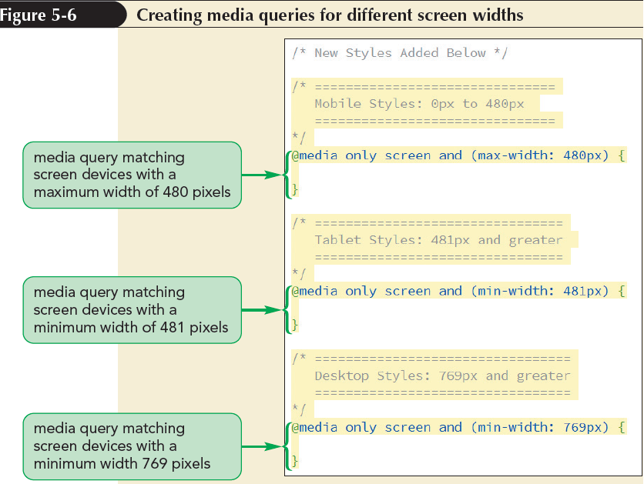
Applying Media Queries to a Style Sheet (continued)

Slide 13
Exploring Viewports and Device Width
Web pages are viewed within a window called the viewport
Mobile devices have two types of viewports:
  Visual viewport – displays the web page content that fits within a mobile screen
  Layout viewport – contains the entire content of the page, some of which may be hidden from the user

Slide 14
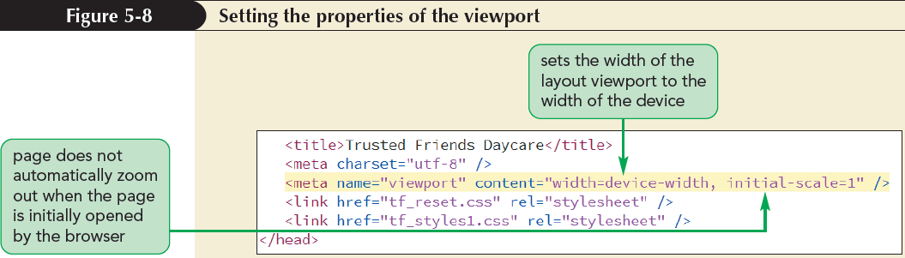
Exploring Viewports and Device Width (continued)

Slide 15
Creating a Mobile Design
Design principles
  Have the most important information up-front and easily accessible
    Means the home page on a mobile device needs to be free of unnecessary clutter
  Limit the choices offered to users
    Means that ideally, there should only be a few navigation links on the screen at any one time

Slide 16
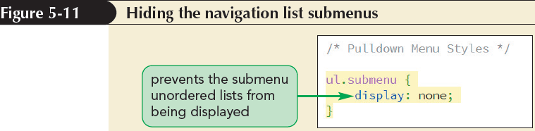
Creating a Pulldown Menu with CSS

Slide 17
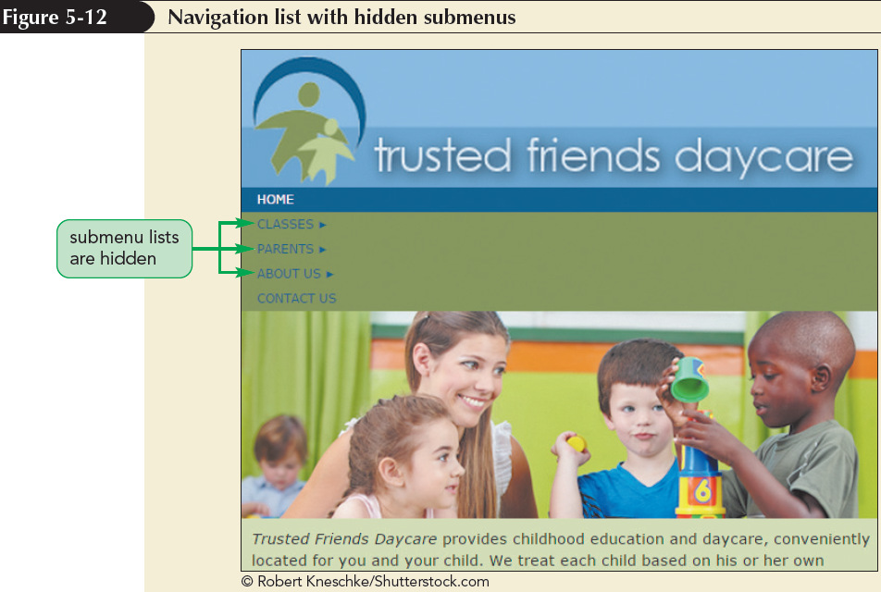
Creating a Pulldown Menu with CSS
(continued 1)

Slide 18
Creating a Pulldown Menu with CSS
(continued 2)
The following selector can be used to select the submenu that is immediately preceded by a hovered submenu title:
    a.submenuTitle:hover+ul.submenu
    In order to keep the submenu visible as the pointer moves away from the title and hovers over the now-visible submenu, use the following:
        a.submenuTitle:hover+ul.submenu, ul.submenu:hover

Slide 19
Creating a Pulldown Menu with CSS
(continued 3)
To make a submenu visible, change its display property back to block, using the following style rule:
a.submenuTitle:hover+ul.submenu, ul.submenu:hover {
display: block;
}
Do not use only the ul.submenu:hover selector
  Because you cannot hover over the submenu until it is visible and it won’t be visible until you first hover over the submenu title

Slide 20
Testing Your Mobile Website
Mobile Emulator | Description
Android SDK | Software development kit for Android developers(developer.android.com/sdk)
iOS SDK | Software development kit for iPhone, iPad, and other iOS devices(developer.apple.com)
Mobile Phone Emulator | Online emulation for a variety of mobile devices(www.mobilephoneemulator.com)
Mobile Test Me | Online emulation for a variety of mobile devices (mobiletest.me)
Opera Mobile SDK | Developer tools for the Opera Mobile browser(www.opera.com/developer)

Slide 21
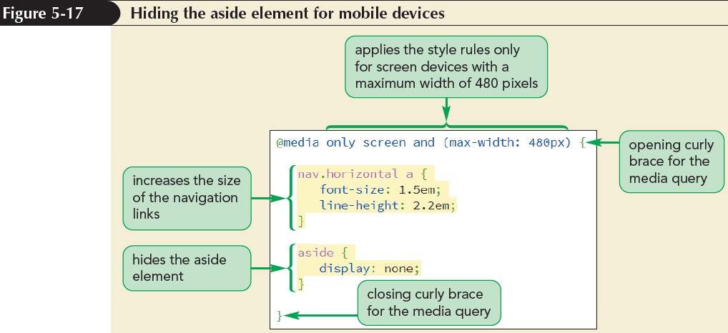
Testing Your Mobile Website (continued)

Slide 22
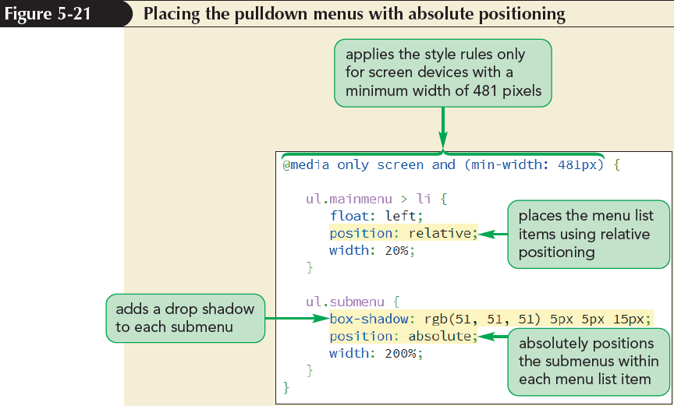
Creating a Tablet Design

Slide 23
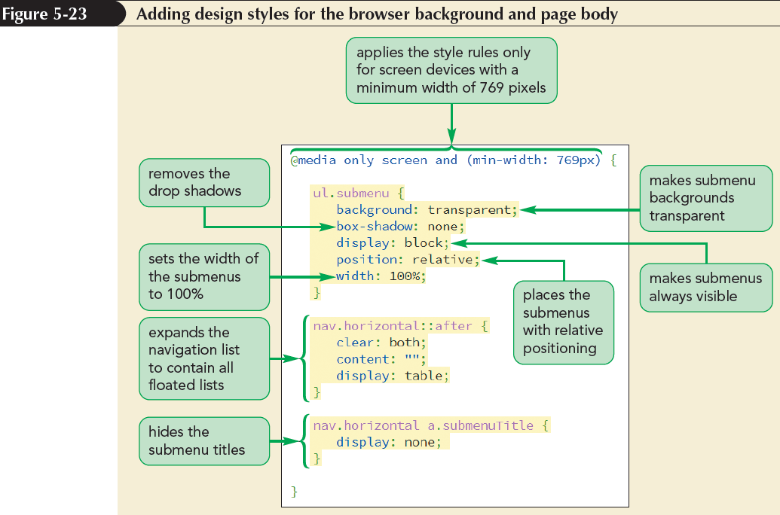
Creating a Desktop Design

Slide 24
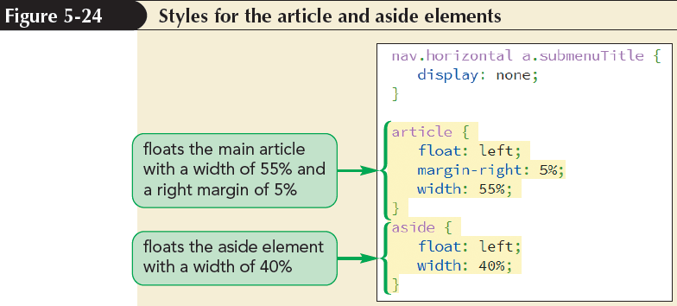
Creating a Desktop Design (continued)

Slide 25
Defining a Flexible Box
A flexible box or flexbox is a box containing items whose sizes can shrink or grow to match the boundaries of the box
Items within a flexbox are laid out along a main axis
The main axis can point in either the horizontal or vertical direction
Cross axis is perpendicular to the main axis and is used to define the height or width of each item

Slide 26
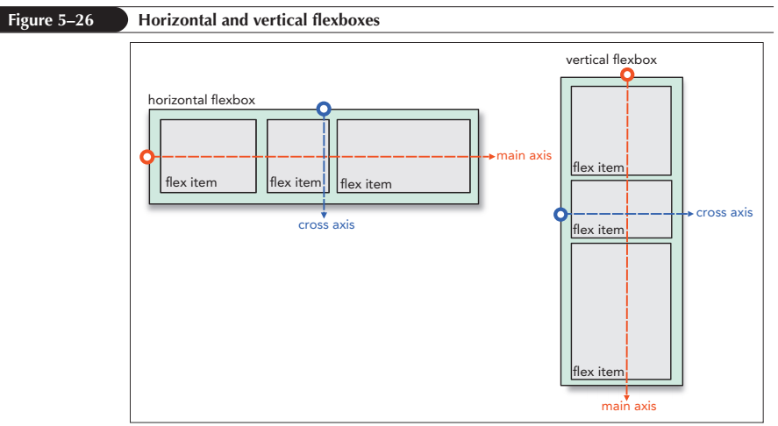
Defining a Flexible Box (continued 1)

Slide 27
Defining a Flexible Box (continued 2)
To define an element as a flexbox, apply either of the following display styles:
display: flex;
or
display: inline-flex;
where a value of flex starts the flexbox on a new line and a value of inline-flex keeps the flexbox in-line with its surrounding content

Slide 28
Cross-Browser Flexboxes
The complete list of browser extensions that define a flexbox is entered as:
display: -webkit-box;
display: -moz-box;
display: -ms-flexbox;
display: -webkit-flex:
display: flex;

Slide 29
Setting the Flexbox Flow
By default, flexbox items are arranged horizontally starting from the left and moving to the right
The orientation of a flexbox can be changed using:
flex-direction: direction;
where direction is row (the default), column, row-reverse, or column-reverse

Slide 30
Setting the Flexbox Flow
(continued 1)
The row option in a flex-direction lays out the flex items from left to right
The column option in a flex-direction creates a vertical layout starting from the top and moving downward
The row-reverse and column-reverse options in a flex-direction lay out the items bottom-to-top and right-to-left respectively

Slide 31
Setting the Flexbox Flow
(continued 2)
Flex items try to fit within a single line, either horizontally or vertically
Flex items can wrap to a new line using the following property:
flex-wrap: type;

Slide 32
Setting the Flexbox Flow
(continued 3)
where type is either:
nowrap (default)
wrap to wrap the flex items to a new line
wrap-reverse to wrap flex items to a new line starting in the opposite direction from the current line

Slide 33
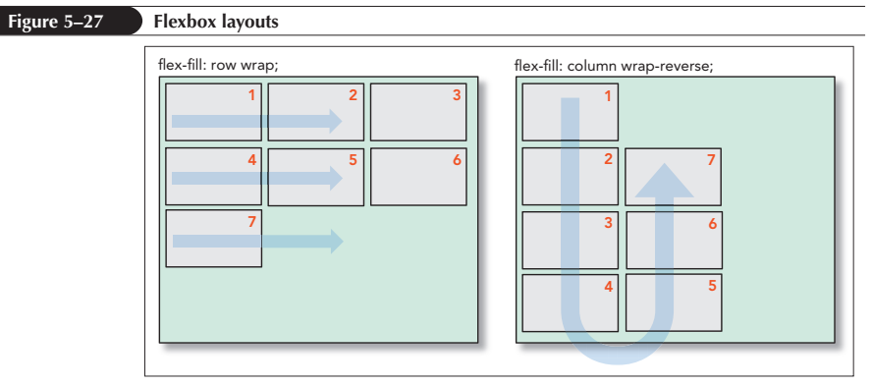
Setting the Flexbox Flow
(continued 4)

Slide 34
Setting the Flex Basis
The flex items are determined by three properties:
  base size
  growth value
  shrink value
The basis size defines the initial size of the item before the browser attempts to fit it to the flexbox

Slide 35
Setting the Flex Basis (continued)
The basis size is set using the following:
flex-basis: size;
where size is one of the CSS units of measurement, which sets the initial size of the flex item based on its content or the value of its width or height property
For example:
aside {flex-basis: 200px;}

Slide 36
Defining the Flex Growth
The rate at which a flex item grows from its basis size is determined by the flex-grow property
flex-grow: value;
where value is a non-negative value that expresses the growth of the flex item relative to the growth of other items in the flexbox
The default flex-grow value is 0, which is equivalent to the flex item remaining at its basis size

Slide 37
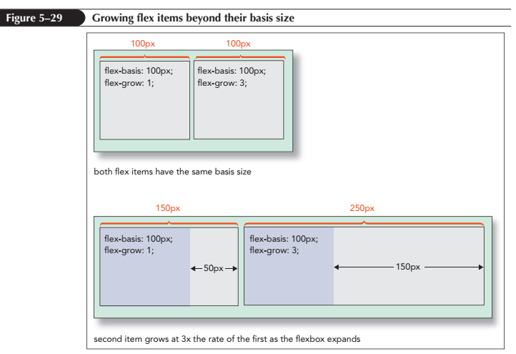
Defining the Flex Growth
(continued 1)

Slide 38
Defining the Flex Growth
(continued 2)
The following style rule creates a layout for navigation list in which each list item is assigned an equal size and grows at the same rate
nav ul {
display: flex;
}
nav ul li {
flex-basis: 0px;
flex-grow: 1;
}

Slide 39
Defining the Shrink Rate
When the flexbox size falls below the total space allotted to its flex items:
  Two possibilities occur depending on whether the flexbox is defined to wrap its contents to a new line
First, if the flexbox-wrap property is set to wrap, one or more of the flex items will be shifted to a new line and expanded to fill in the available space on that line

Slide 40
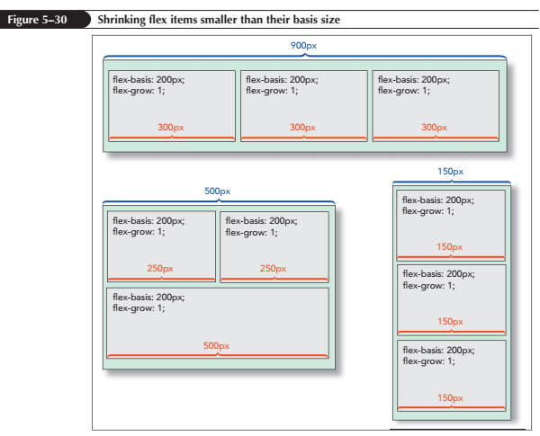
Defining the Shrink Rate (continued 1)

Slide 41
Defining the Shrink Rate (continued 2)
Second, if the flexbox does not wrap to a new line as it is resized, then the flex items will continue to shrink, still sharing the same row or column
The rate at which flexboxes shrink below their basis size is given by the following property:
flex-shrink: value;

Slide 42
Defining the Shrink Rate (continued 3)
where value is a non-negative value that expresses the shrink rate of the flex item relative to the shrinkage of the other items in the flexbox
The default flex-shrink value is 1
If the flex-shrink value is set to 0, then the flex item will not shrink below its basis

Slide 43
The flex Property
The syntax for the flex property is:
flex: grow shrink basis;
where grow defines the growth of the flex item, shrink provides its shrink rate, and basis sets the item’s initial size
The default flex value is:
flex: 0 1 auto;
which automatically sets the size of the flex item to match its content or the value of its width and height property

Slide 44
The flex Property (continued)
The flex property supports the following keywords:
  auto – Use to automatically resize the item from its default size (equivalent to flex: 1 1 auto;)
  initial – The default value (equivalent to flex: 0 1 auto;)
  none – Use to create an inflexible item that will not grow or shrink (equivalent to flex: 0 0 auto;)
  inherit – Use to inherit the flex values of its parent element

Slide 45
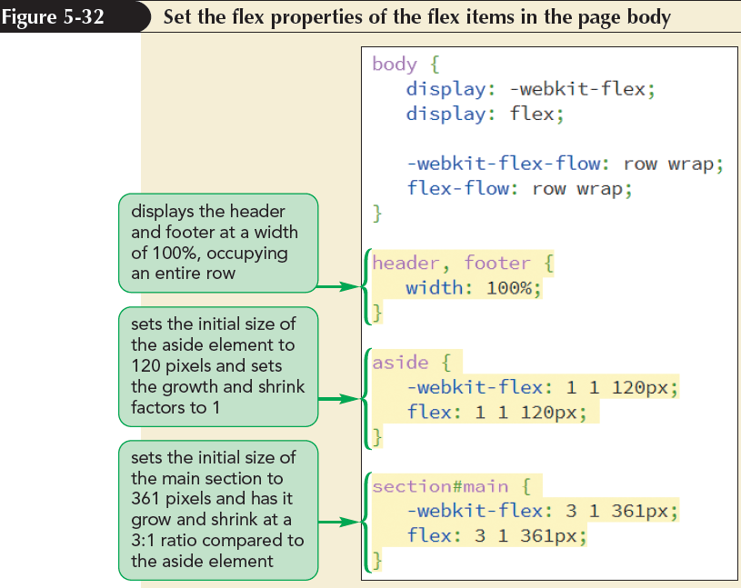
Applying a Flexbox Layout

Slide 46
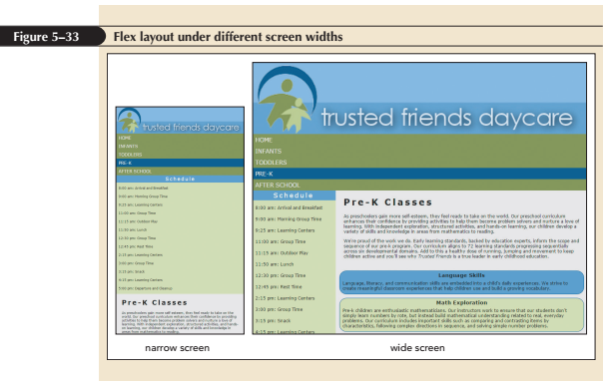
Applying a Flexbox Layout (continued)

Slide 47
Reordering Page Content with Flexboxes
The flexbox model allows to place the flex items in any order using the following order property:
order: value;
where value is an integer where items with smaller order values are placed before items with larger order values

Slide 48
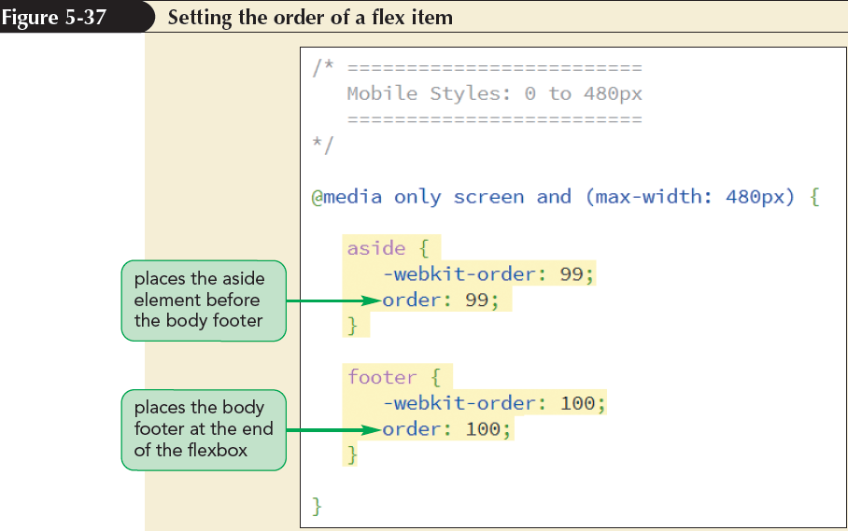
Reordering Page Content with Flexboxes (continued)

Slide 49
Aligning Items along the Main Axis
By default, flex items are laid down at the start of the main axis
To specify a different placement, apply the following justify-content property
justify-content: placement;
where placement is one of the following keywords:
flex-start – Items are positioned at the start of the main axis (the default)

Slide 50
Aligning Items along the Main Axis (continued)
flex-end – Items are positioned at the end of the main axis
center – Items are centered along the main axis
space-between – Items are distributed evenly with the first and last items aligned with the start and end of the main axis
space-around – Items are distributed evenly along the main axis with equal space between them and the ends of the flexbox

Slide 51
Aligning Flex Lines
The align-content property is similar to the justify-content property except that it arranges multiple lines of content along the flexbox’s cross axis
The syntax of the align-content property is:
align-content: value;
where value is one of the following keywords:
flex-start - Lines are positioned at the start of the cross axis

Slide 52
Aligning Flex Lines (continued 1)
flex-end - Lines are positioned at the end of the cross axis
stretch - Lines are stretched to fill up the cross axis (the default)
center - Lines are centered along the cross axis
space-between - Lines are distributed evenly with the first and last lines aligned with the start and end of the cross axis

Slide 53
Aligning Flex Lines (continued 2)
space-around - Lines are distributed evenly along the cross axis with equal space between them and the ends of the cross axis

Slide 54
Aligning Items along the Cross Axis
The align-items property aligns each flex item about the cross axis
The syntax is:
align-items: value;
where value is one of the following keywords:
flex-start – Items are positioned at the start of the cross axis
flex-end – Items are positioned at the end of the cross axis

Slide 55
Aligning Items along the Cross Axis (continued 1)
center – Items are centered along the cross axis
stretch – Items are stretched to fill up the cross axis (the default)
baseline – Items are positioned so that the baselines of their content align

Slide 56
Aligning Items along the Cross Axis (continued 2)
The align-items property is only impactful when there is a single line of flex items
The align-content property is used to layout the flexbox content for multiple lines of flex items

Slide 57
Aligning Items along the Cross Axis (continued 3)
To align a single item out of a line of flex items, use the following align-self property:
align-self: value;
where value is one of the alignment choices supported by the align-self property

Slide 58
Creating a Navicon Menu
Navicon – It is used to indicate the presence of hidden navigation menus in mobile websites
The navicon is a symbol represented as three horizontal lines
When a user hovers or touches the navicon, the navigation menu is revealed

Slide 59
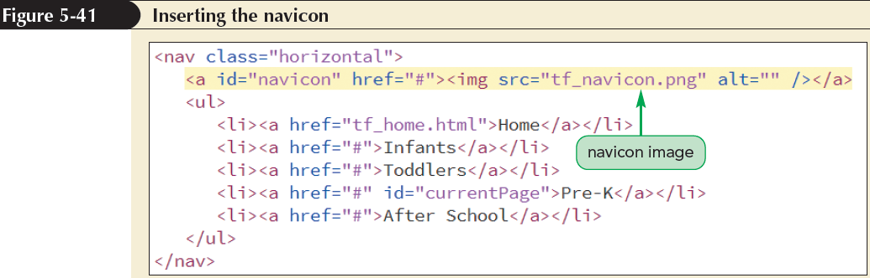
Creating a Navicon Menu
(continued)

Slide 60
Designing for Printed Media
A print style sheet formats the printed version of a web document
Browsers support their own internal style sheet to format the print versions of the
web pages they encounter
  Their default styles might not always result in the best printouts

Slide 61
Applying a Media Query for Printed Output
To apply a print style sheet, the media attribute is used in the link elements to target style sheets to either screen devices or print devices

Slide 62
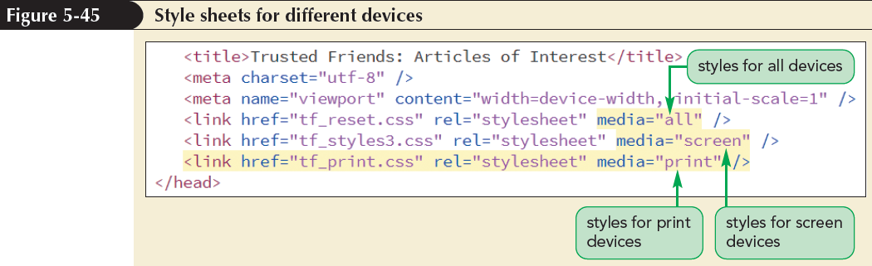
Applying a Media Query for Printed Output (continued)

Slide 63
Working with the @page Rule
Every printed page in CSS is defined as a page box
A page box is composed of two areas:
  Page area – contains the content of the document
  Margin area – contains the space between the printed content and the edges of the page

Slide 64
Working with the @page Rule (continued)
Styles are applied to the page box using:
@page {
style rules
}
where style rules are the styles applied to the page
The styles are limited to defining the page size and the page margin

Slide 65
Setting the Page Size
The following size property allows web authors to define the dimensions of a printed page:
    size: width height;
    where width and height are the width and height of the page
  The keyword auto lets browsers determine the page dimensions
  The keyword inherit inherits the page size from the parent element

Slide 66
Using the Page Pseudo-Classes
Different styles can be defined for different pages by adding the following:
    @page:pseudo-class {
    style rules
    }
    where pseudo-class is first for the first page of the printout, left for the pages that appear on the left in the double-sided printouts, or right for pages that appear on the right in double-sided printouts

Slide 67
Page Names and the Page Property
To define styles for pages other than the first, left, or right, create a page name as follows:
    @page name {
    style rules
    }
    where name is the label given to the page

Slide 68
Page Names and the Page Property (continued)
  To assign a page name to an element, use
      selector {
      page: name;
      }
      where selector identifies the element that will be displayed on its own page, and name is the name of a previously defined page style

Slide 69
Formatting Hypertext Links for Printing
To append the text of a link’s URL to the linked text, apply the following style rule:
    a::after {
    content: “ (“ attr(href) “) “;
    }
    This style rule uses the after pseudo-element along with the content property and the attr() function to retrieve the text of the href attribute and add it to the contents of the a element

Slide 70
Formatting Hypertext Links for Printing (continued 1)
The word-wrap property is used to break long text strings at arbitrary points if it extends beyond the boundaries of its container

Slide 71
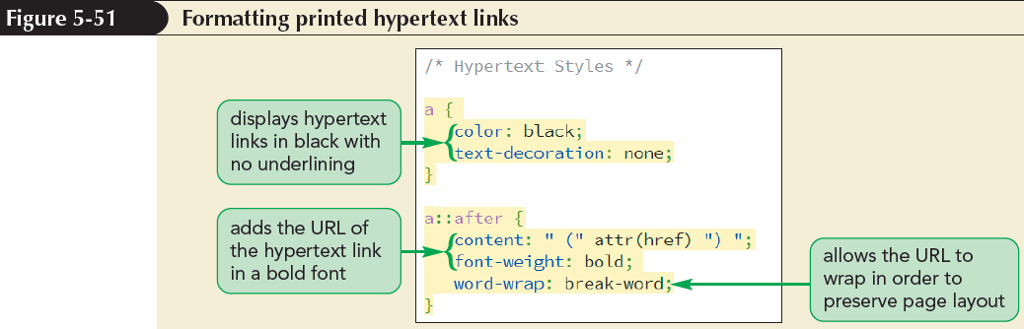
Formatting Hypertext Links for Printing (continued 2)

Slide 72
Working with Page Breaks
Page breaks can be inserted either directly before or after an element, using the following properties:
    page-break-before: type;
    page-break-after: type;
    where type has the following possible values:
    always – Use to always place a page break before or after the element
    avoid – Use to never place a page break

Slide 73
Working with Page Breaks (continued)
      left – Use to place a page break where the next page will be a left page
      right – Use to place a page break where the next page will be a right page
      auto – Use to allow the printer to determine whether or not to insert a page break
      inherit – Use to insert the page break style from the parent element

Slide 74
Preventing Page Breaks
Page breaks can be prevented by using the keyword avoid in the page-break-after or page-break-before properties
For example, the following style rule prevents page breaks from being added after any heading
    h1, h2, h3, h4, h5, h6 {
    page-break-after: avoid;
    }

Slide 75
Working with Widows and Orphans
Page breaks within block elements, such as paragraphs, often leave behind widows and orphans
A widow is a fragment of text left dangling at the top of a page
An orphan is a text fragment left at the bottom of a page

Slide 76
Working with Widows and Orphans (continued)
To control the size of widows and orphans, CSS supports the following properties:
    widows: value;
    orphans: value;
    where value is the number of lines that must appear within the element before a page break can be inserted by printer

